Slide 1
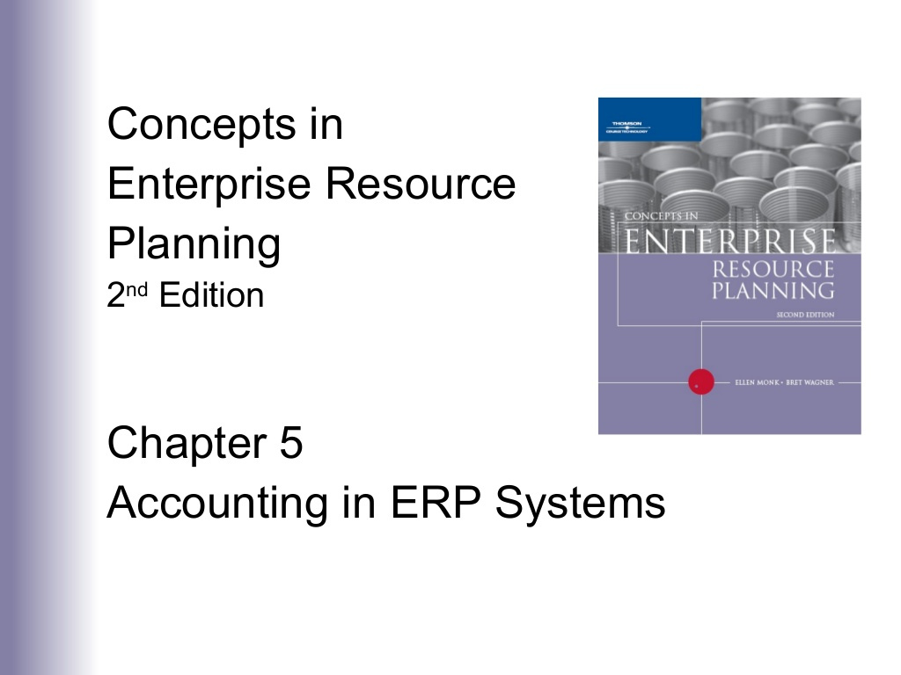

Slide 2
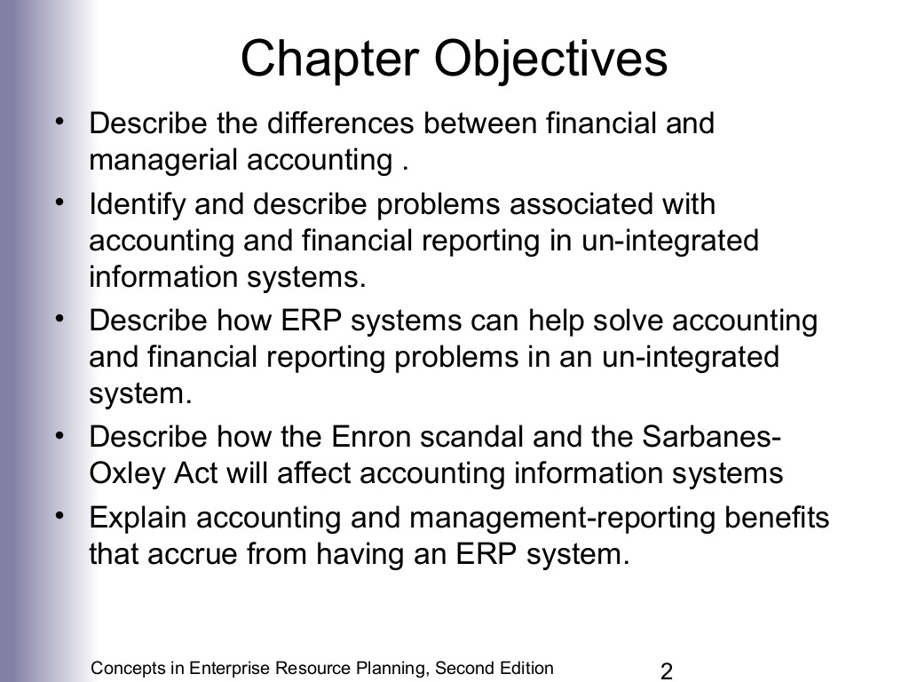

Slide 3
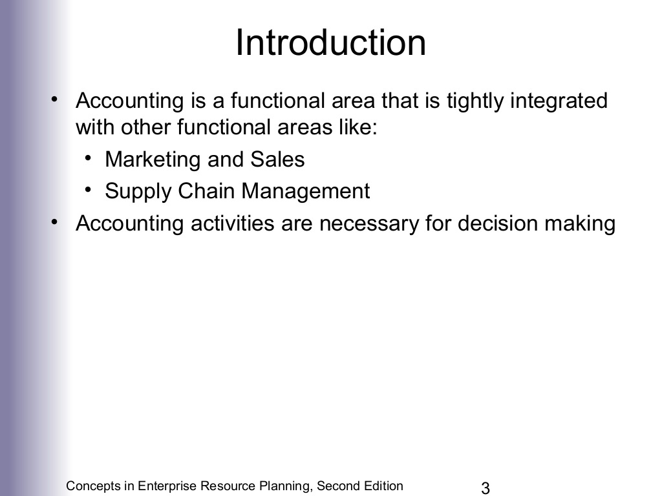

Slide 4
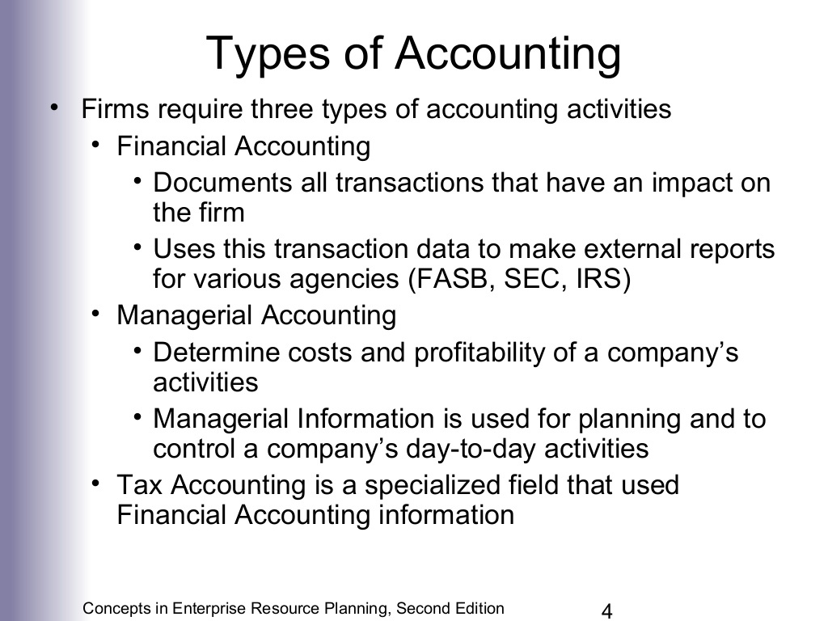

Slide 5
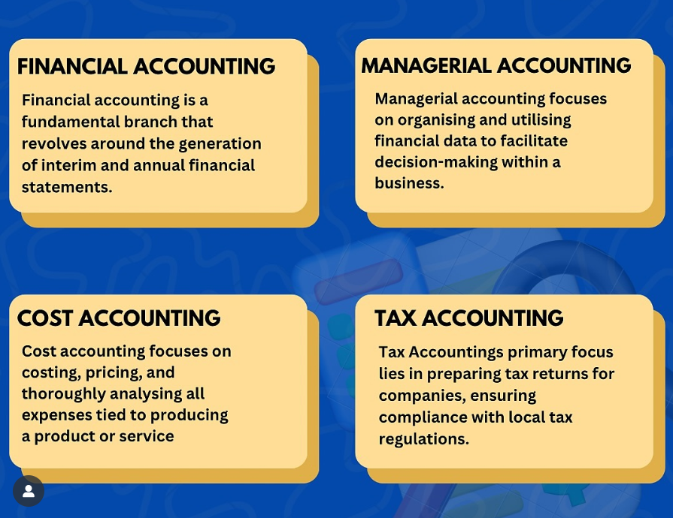

Slide 6
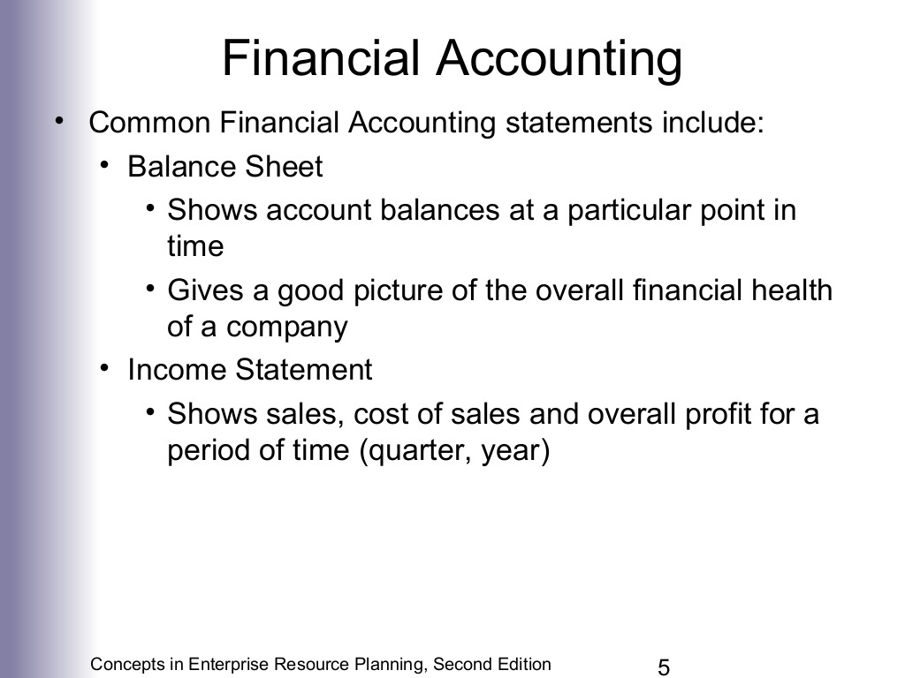

Slide 7
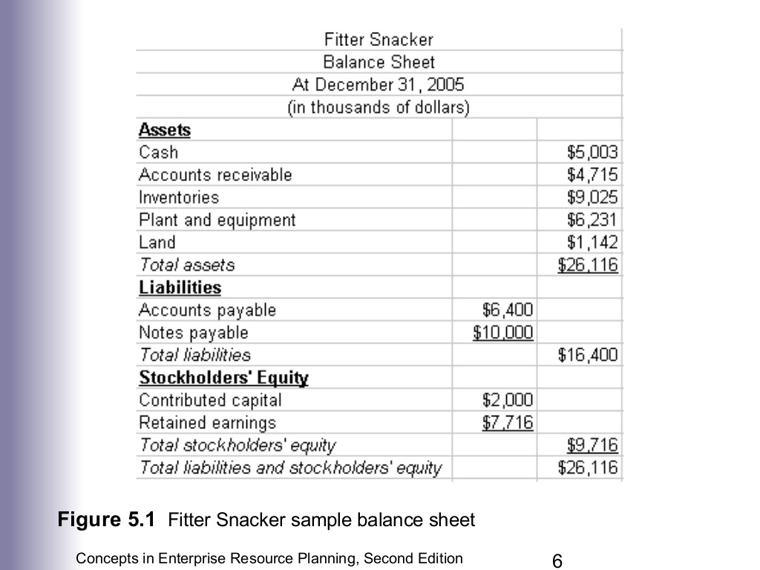

Slide 8
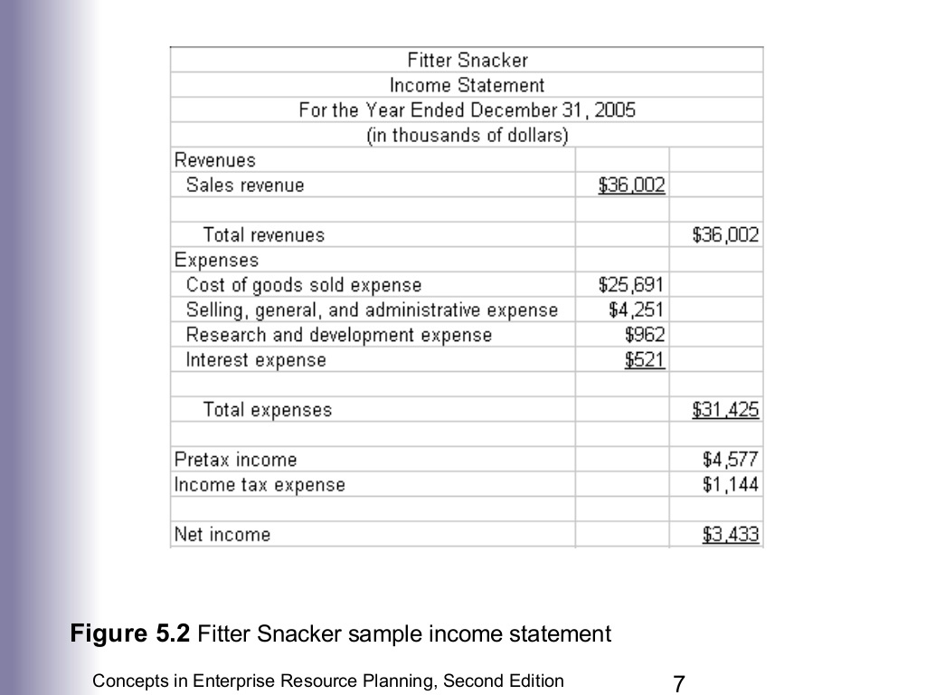

Slide 9
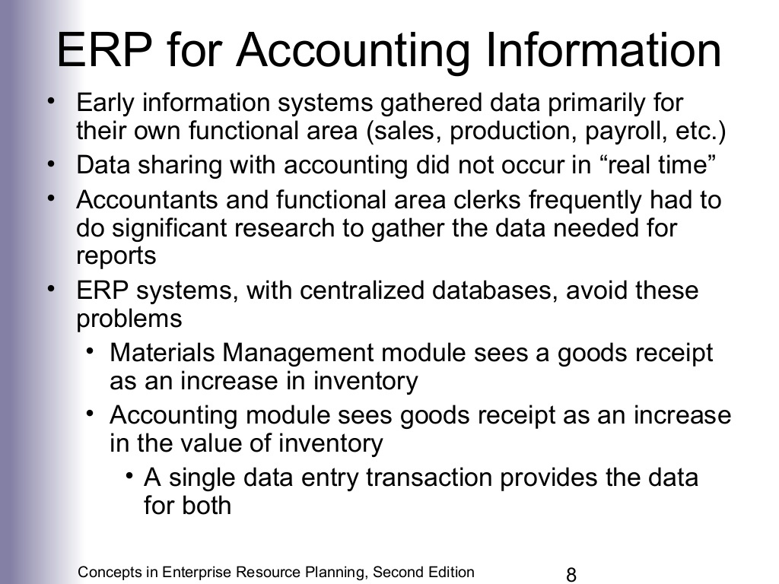

Slide 10
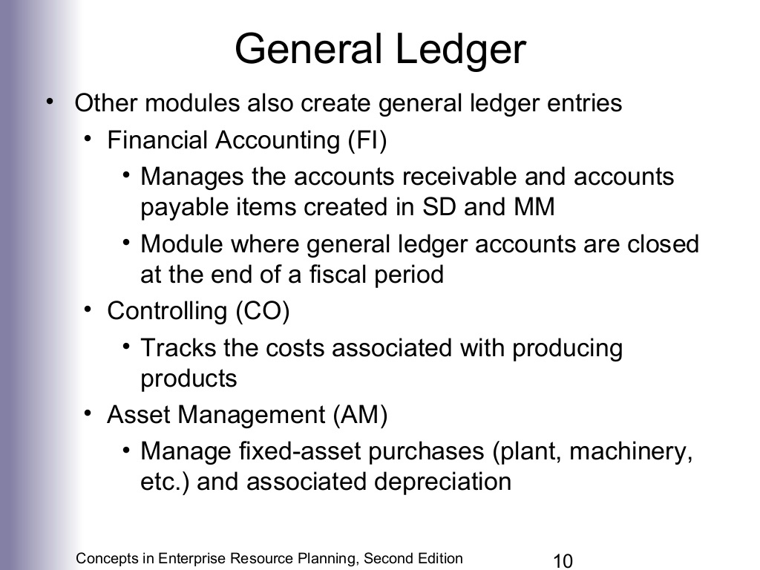
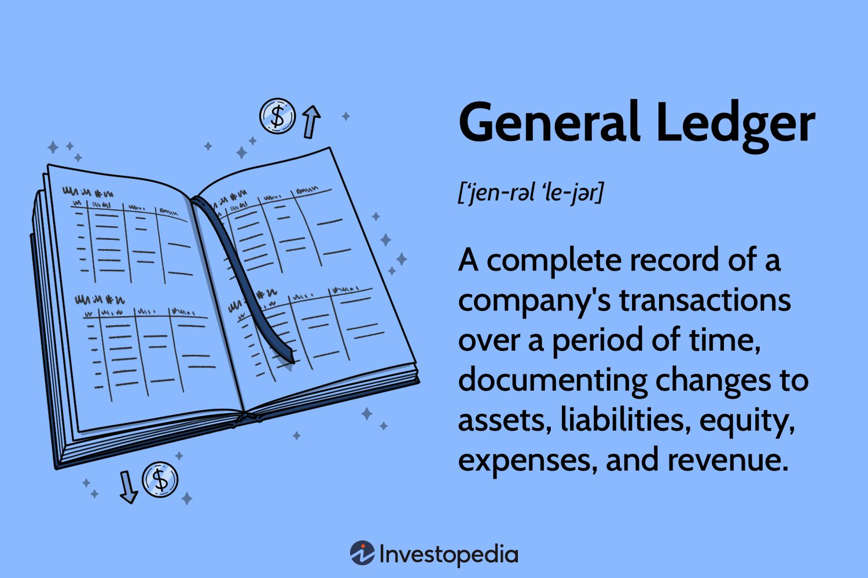

Slide 11
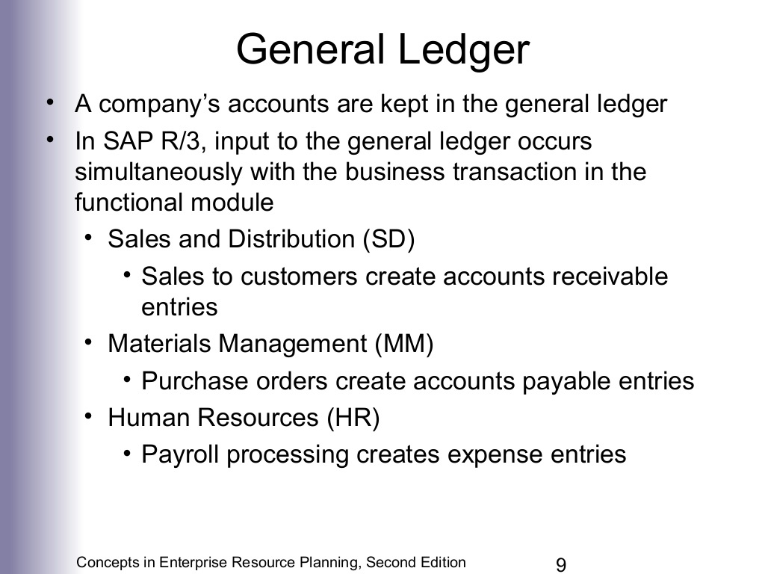

Slide 13
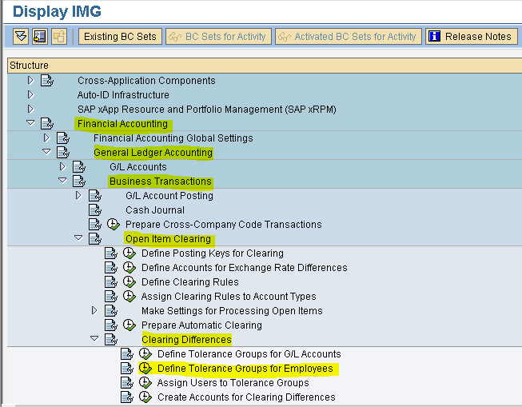

Slide 14
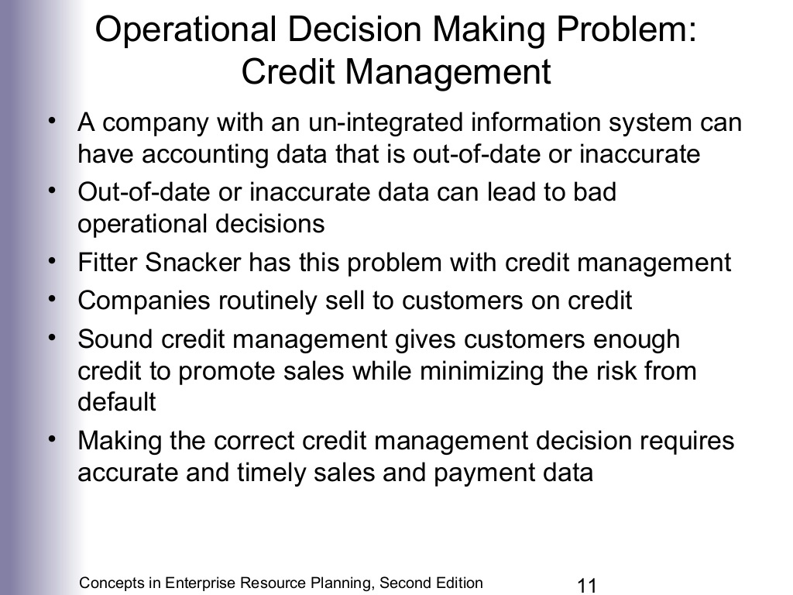
Many companies let customers buy on credit.
Good credit management helps:
Increase sales
(by giving credit to trusted customers).
Reduce risk
(by not giving credit to risky customers).

Slide 16
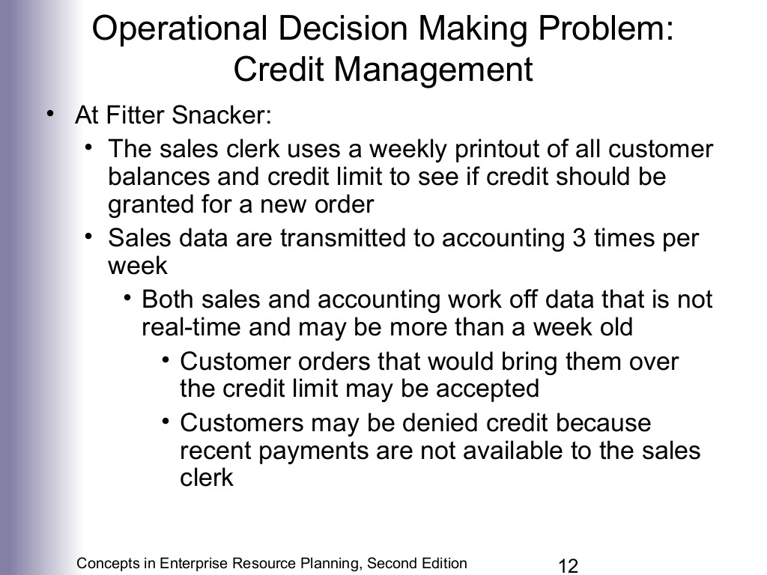


Weekly Printout Preparation
Sales clerk receives a weekly printout from Accounting Department of:
Customer balances
Credit limits
Order Evaluation
When a new customer order comes in:
The sales clerk checks the printout to decide whether to approve credit.
Data Delay
The printout may be outdated (up to a week old).
Sales data is only sent to accounting 3 times a week, causing further delay.
Impact on Decisions
Because the data is not real-time:
Orders may be wrongly accepted (if customer has already exceeded credit).
Orders may be wrongly denied (if recent payments are not shown yet).
Original Credit Management Process Flow at Fitter Snacker
Weekly Printout Preparation
Sales clerk receives a weekly printout of:
Customer balances
Credit limits
Order Evaluation
When a new customer order comes in:
The sales clerk checks the printout to decide whether to approve credit.
Data Delay
The printout may be outdated (up to a week old).
Sales data is only sent to accounting 3 times a week, causing further delay.
Impact on Decisions
Because the data is not real-time:
Orders may be wrongly accepted (if customer has already exceeded credit).
Orders may be wrongly denied (if recent payments are not shown yet).

Slide 17
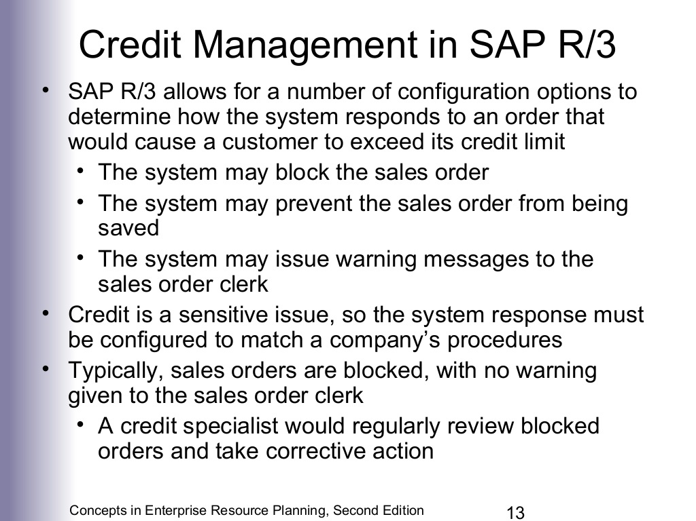

Slide 18
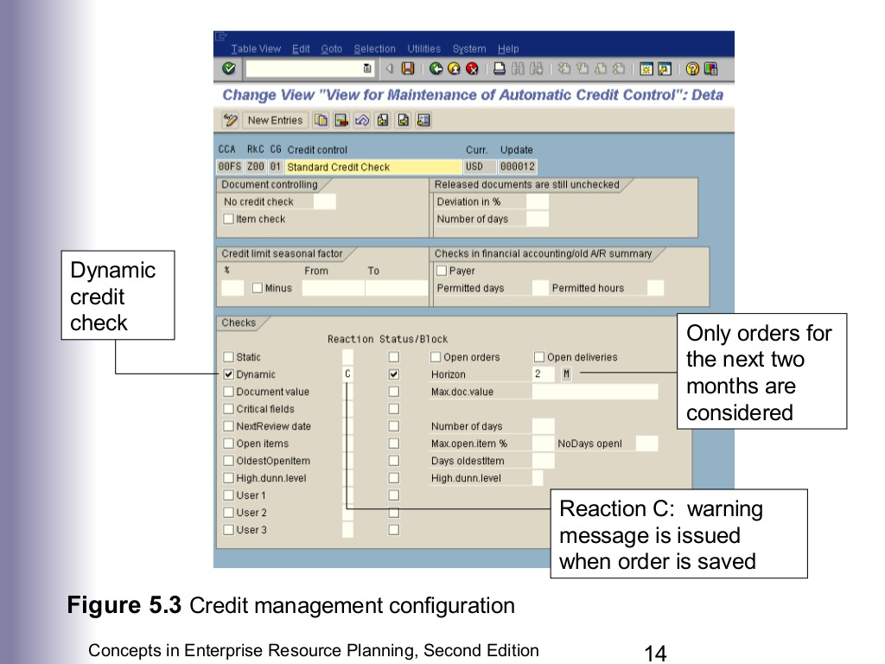

Slide 19
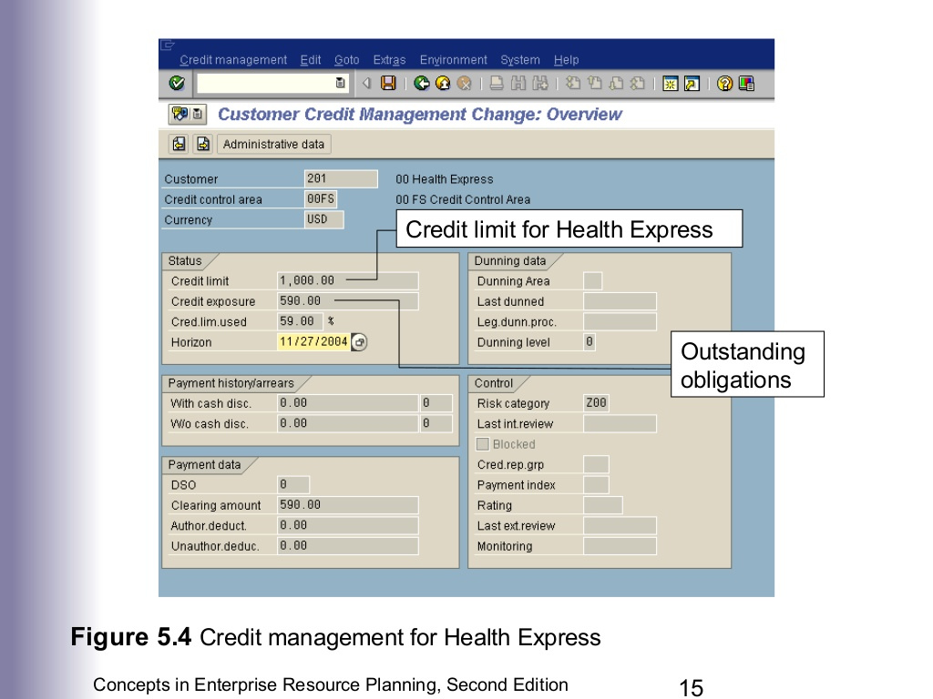

Slide 20
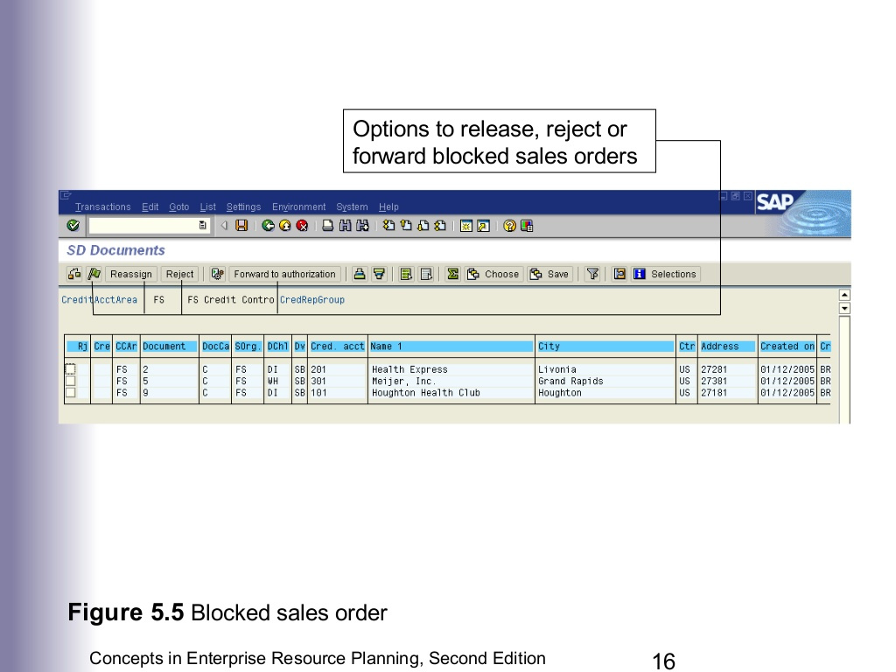

Slide 21
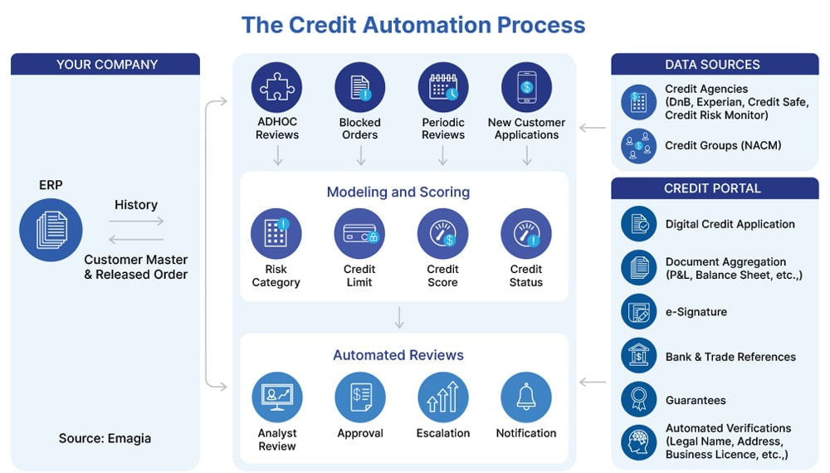

Slide 22
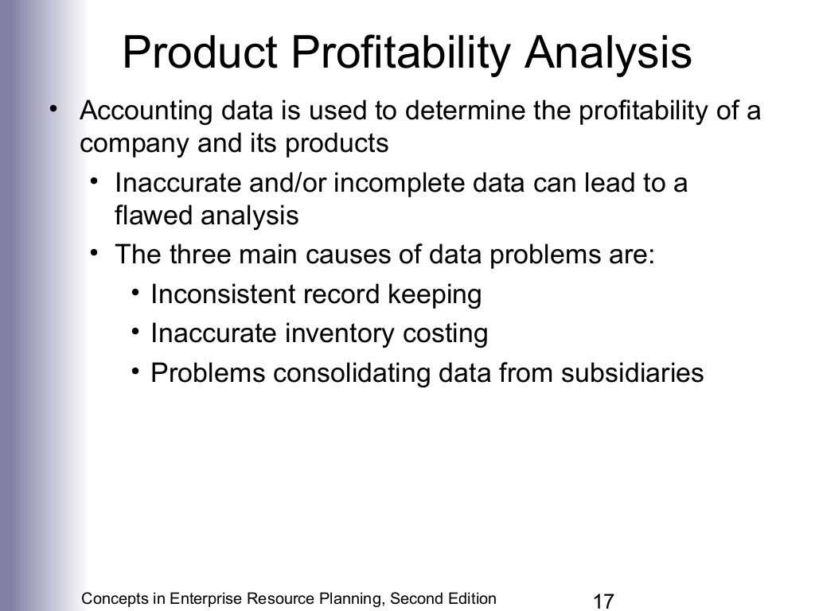
Inconsistent Record Keeping
Different departments record data separately, leading to errors in profit calculations.
Outdated or mismatched inventory data results in inaccurate cost and profit figures.
Problems Consolidating Data from Subsidiaries
Incorrect Inventory Costing

Slide 23
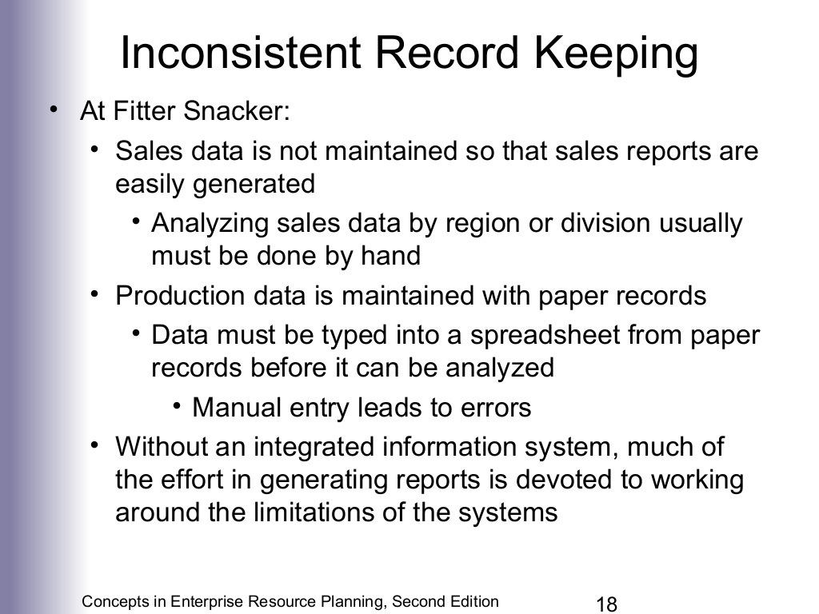



Slide 24
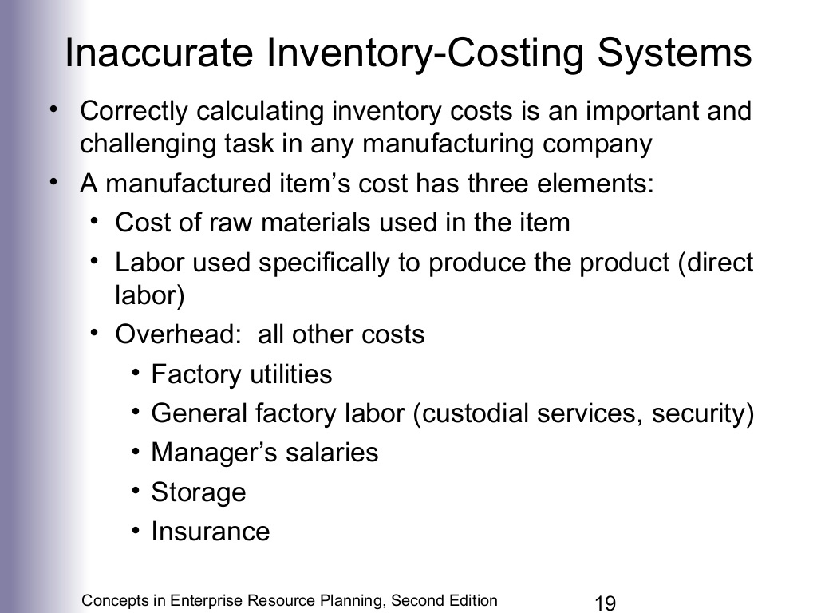


Slide 25
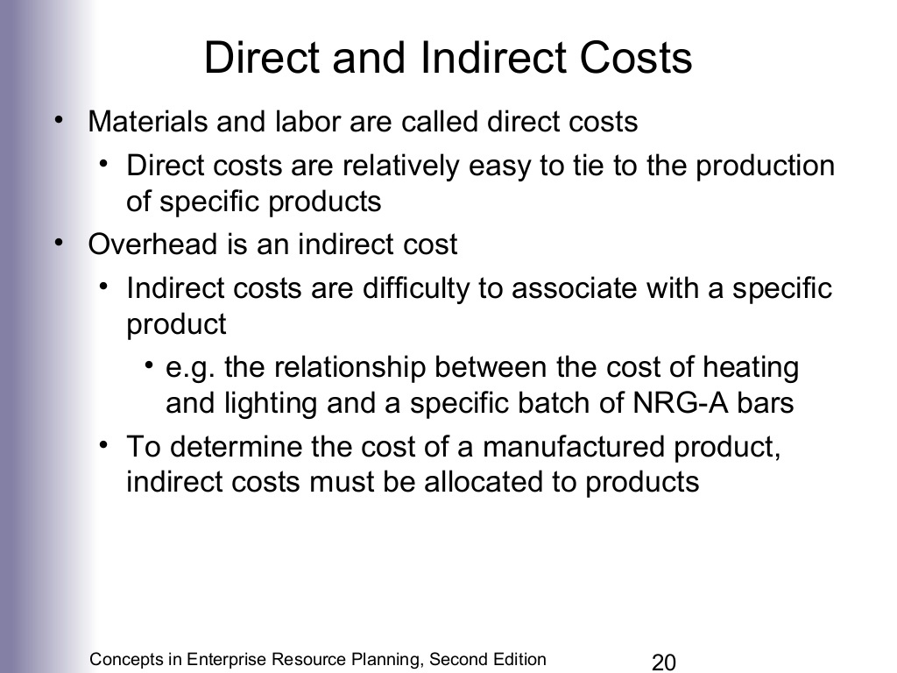

Slide 26
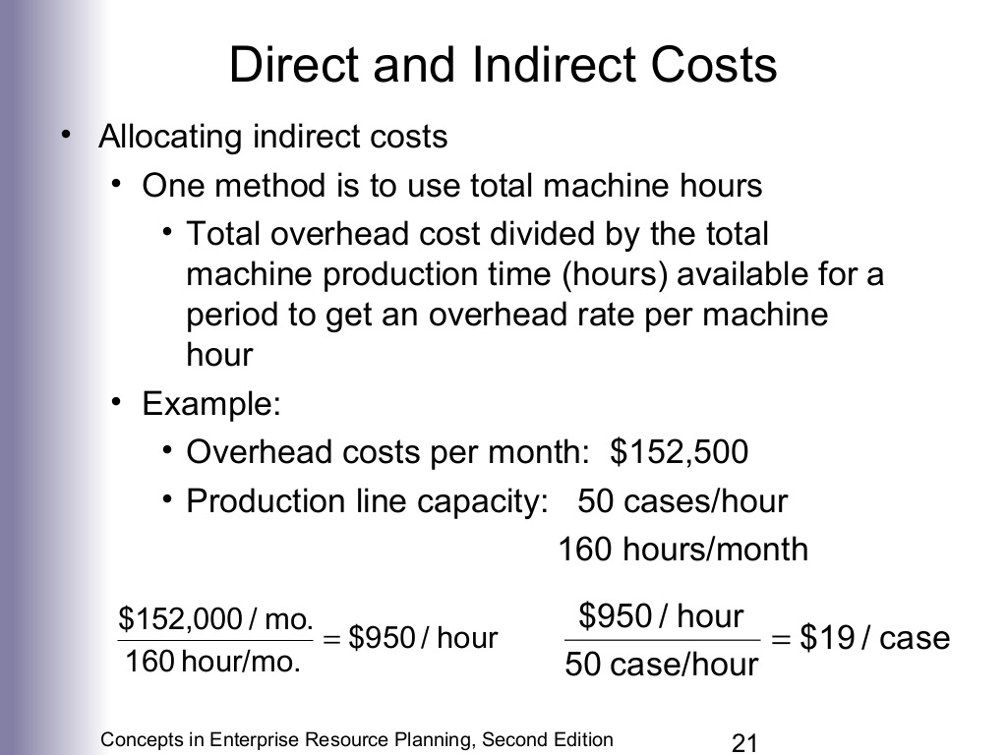

Slide 27
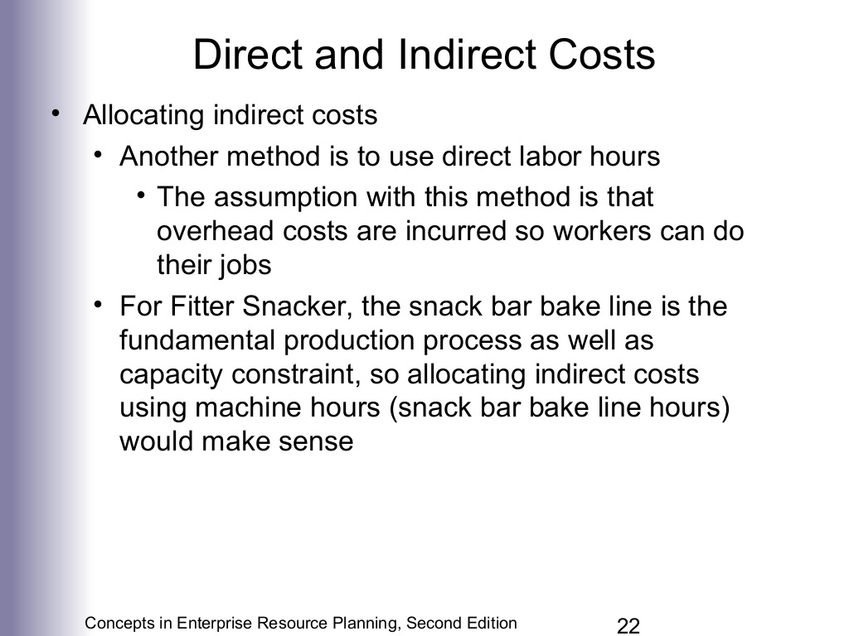

Slide 28
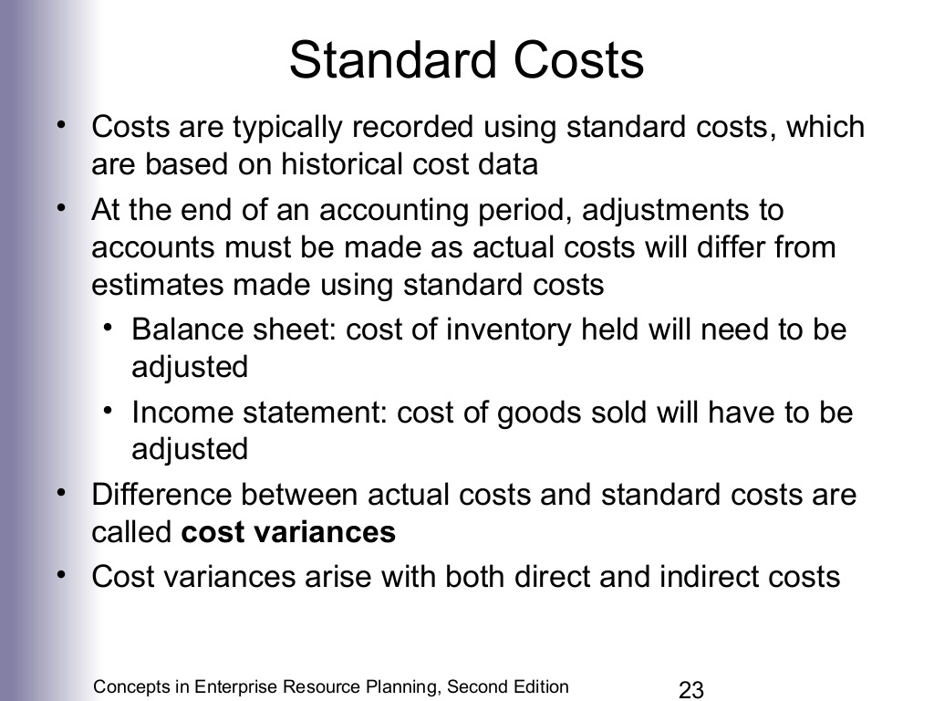

Slide 29
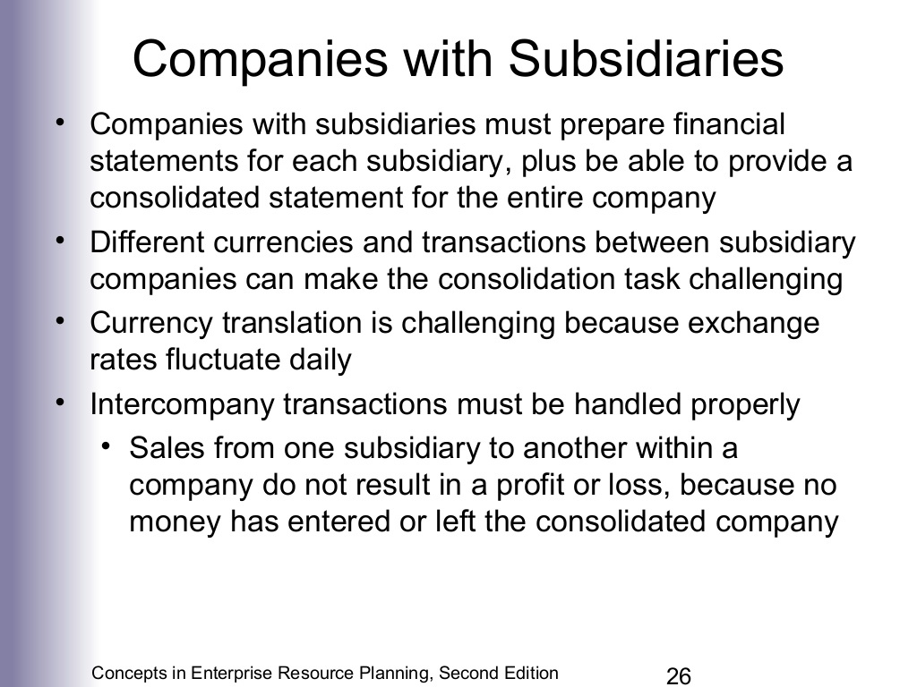


Slide 30
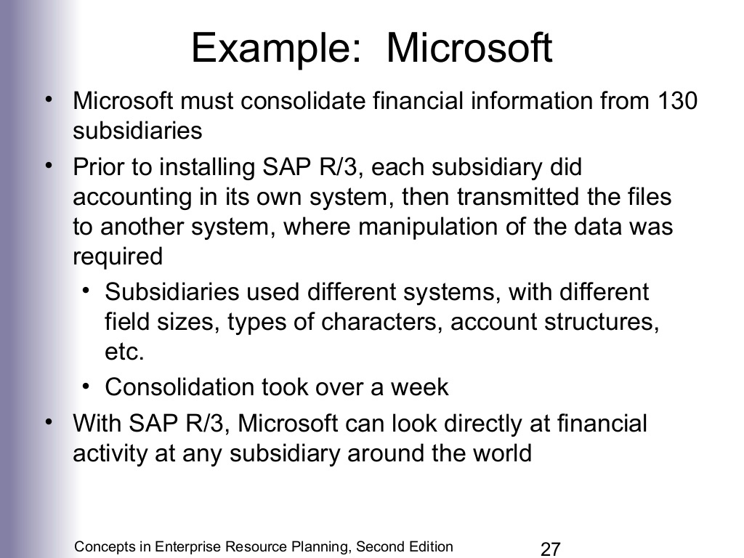

Slide 31
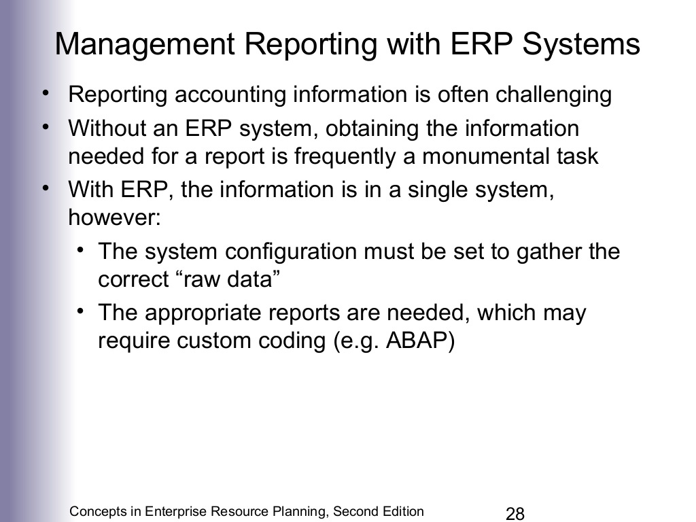

Slide 32
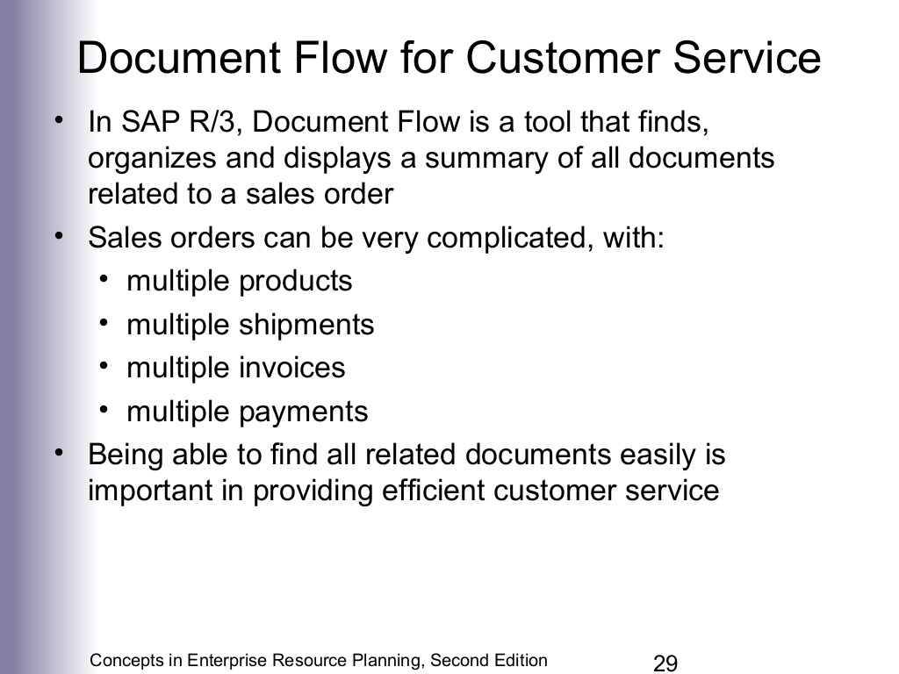

Slide 33
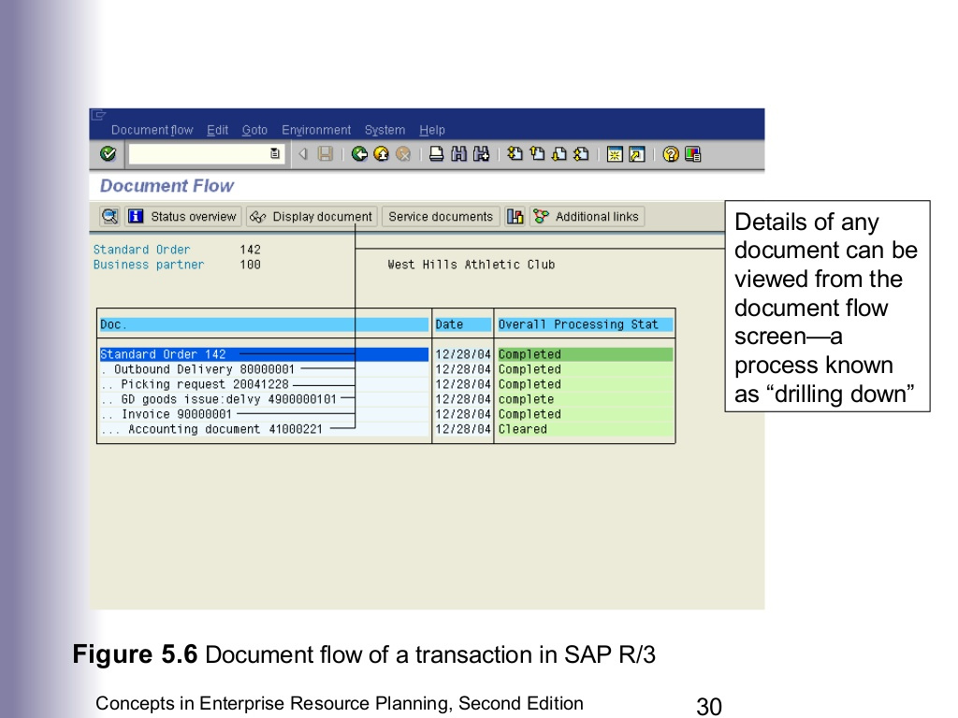

Slide 34
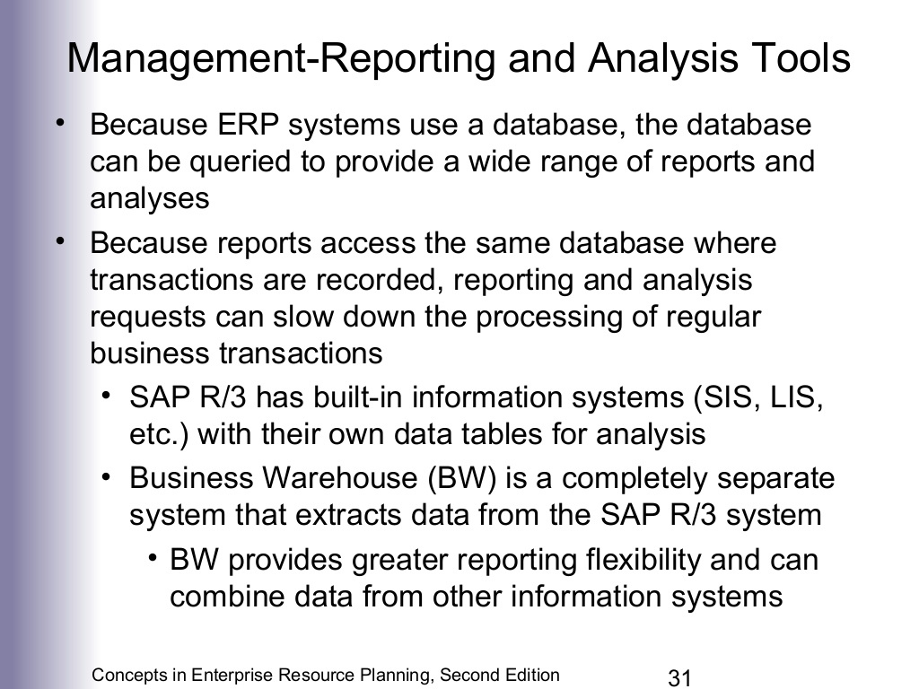

Slide 35
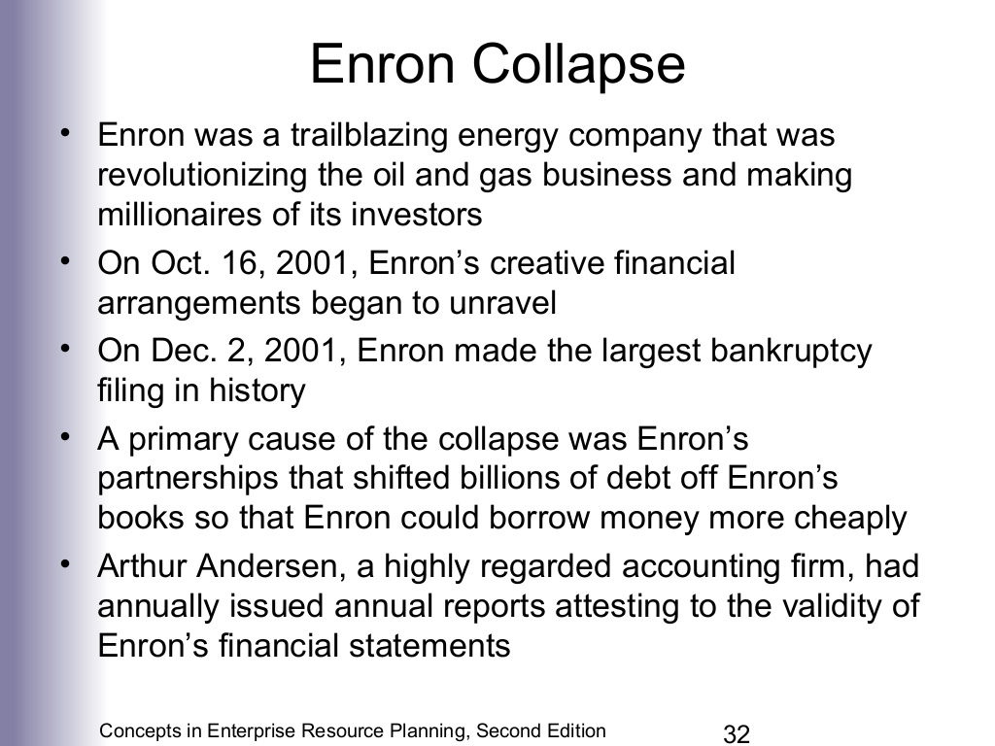

Slide 36
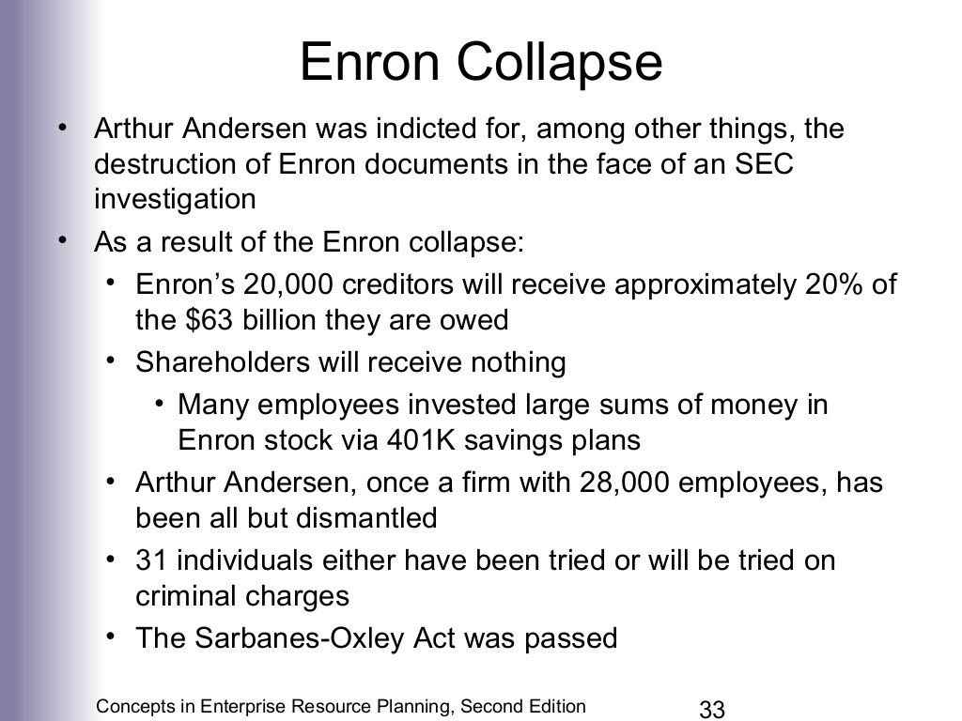

Slide 37
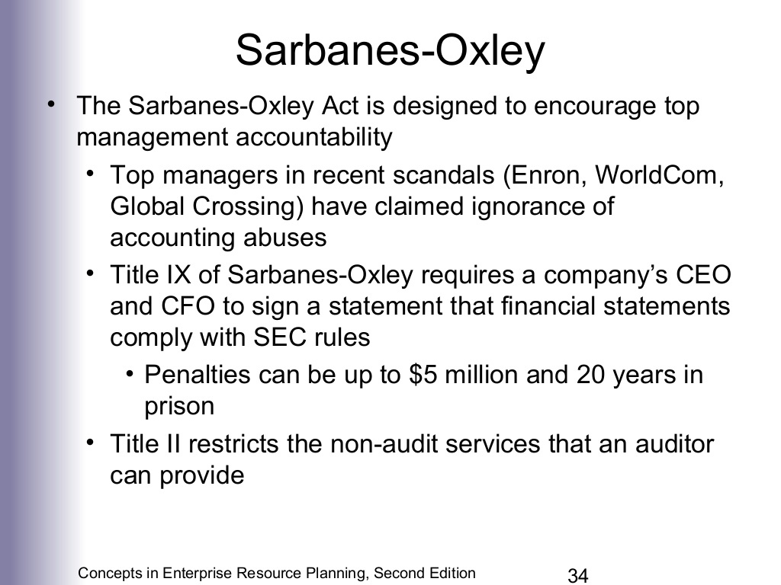

Slide 38
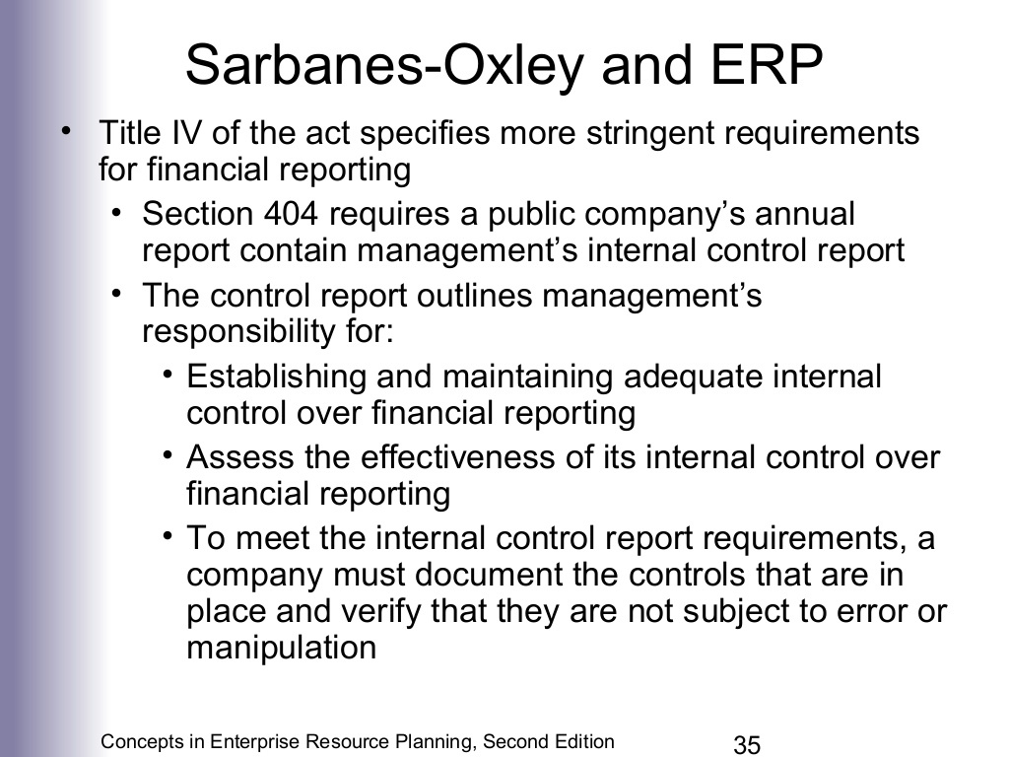

Slide 39
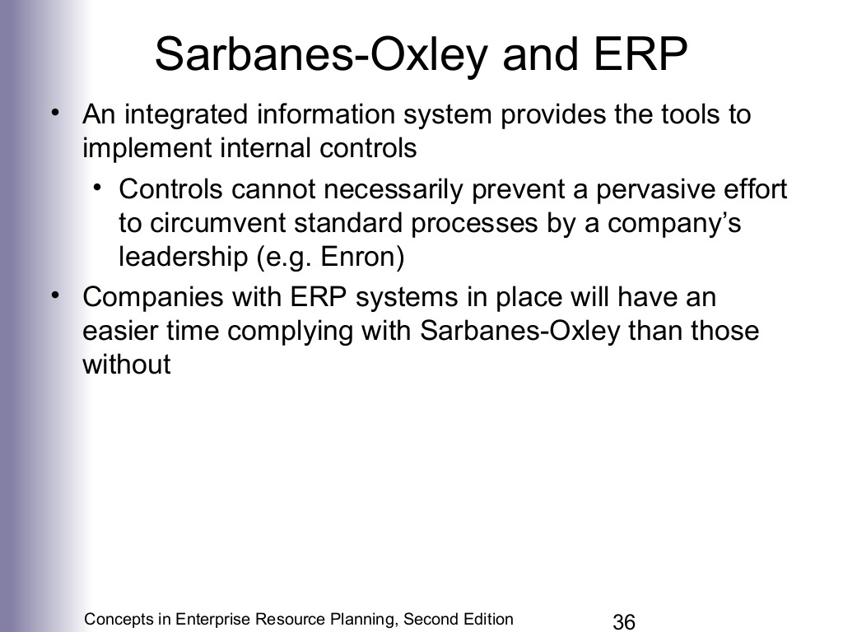

Slide 40
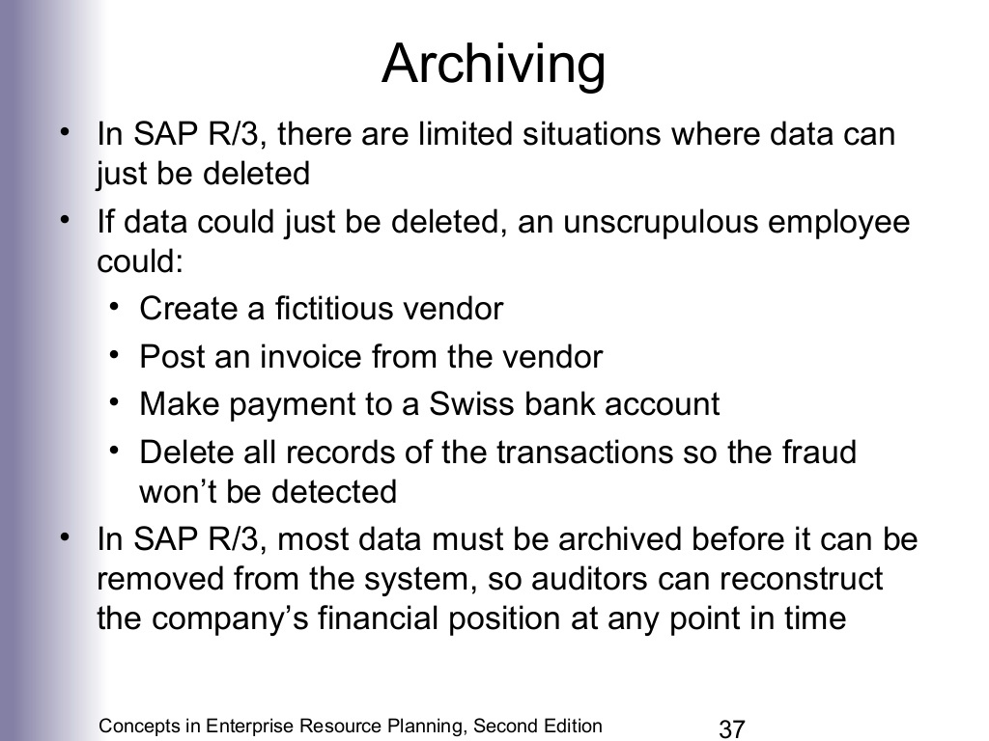

Slide 41
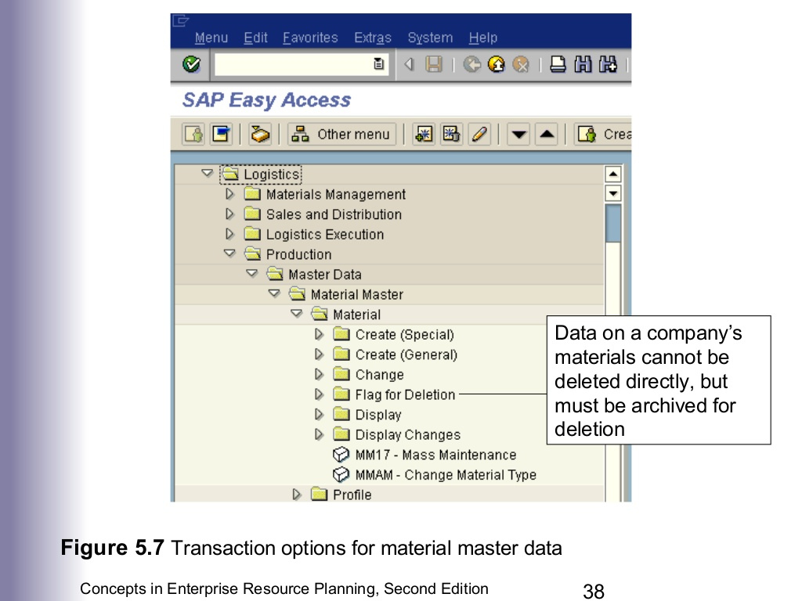

Slide 42
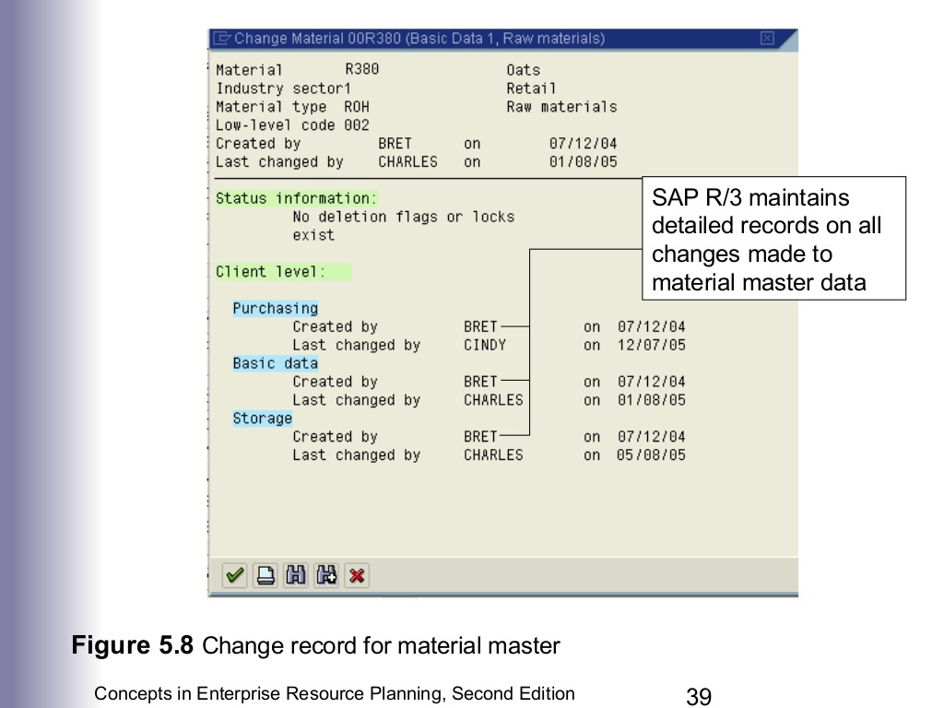

Slide 43
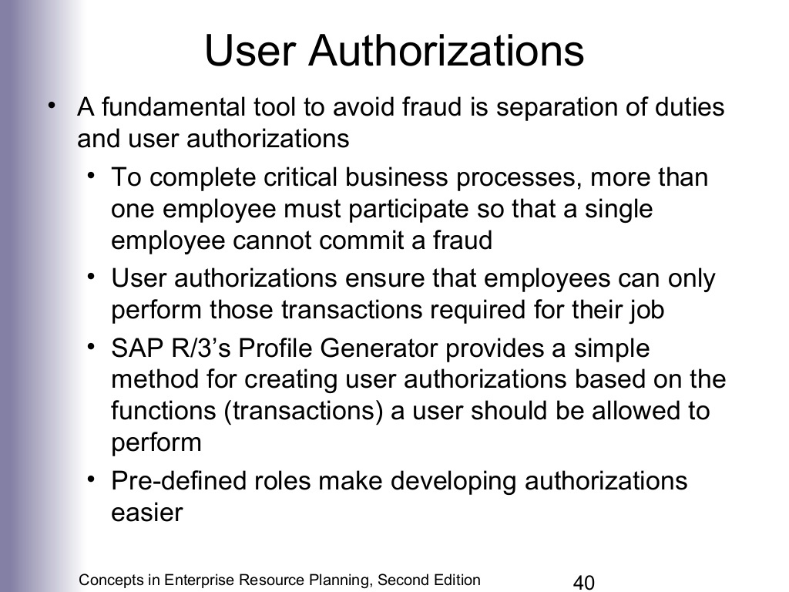

Slide 44
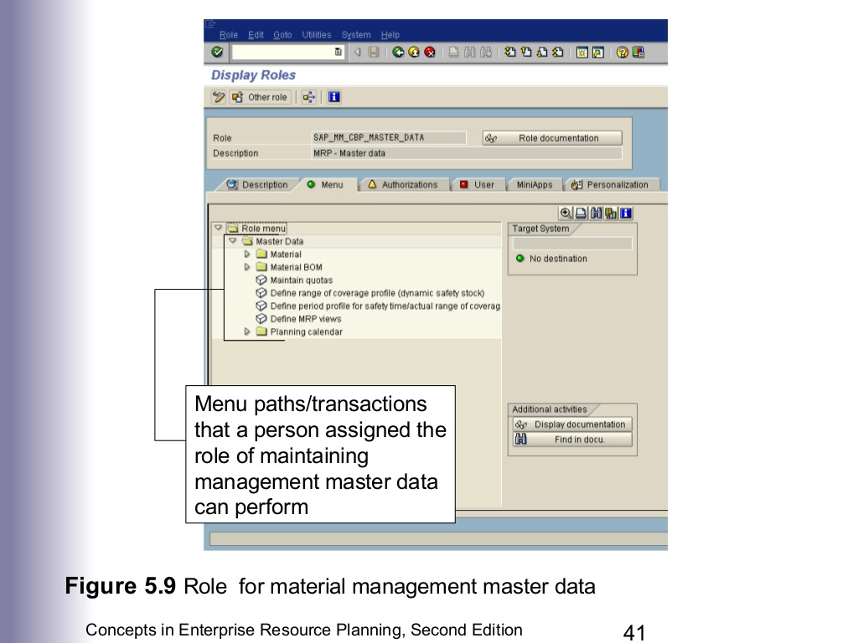

Slide 45
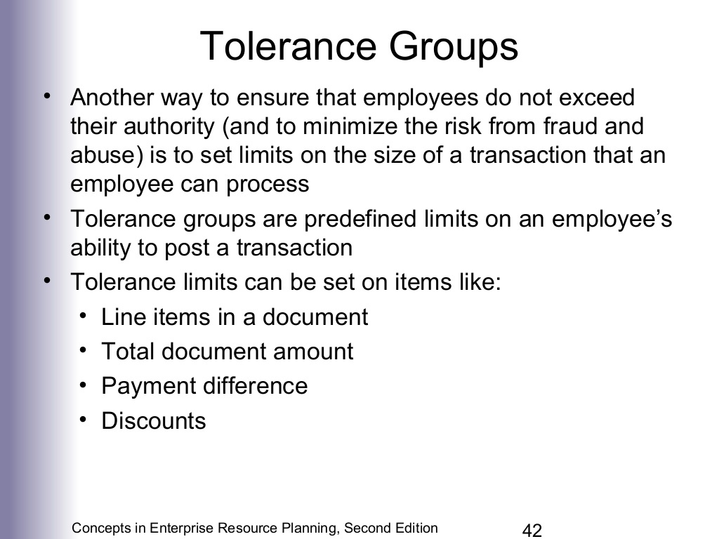

Slide 46
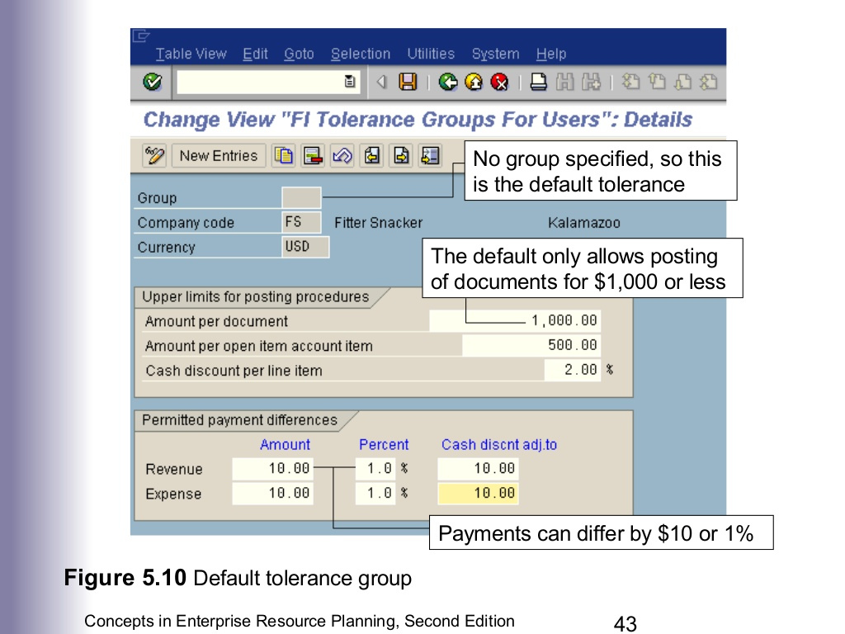

Slide 47
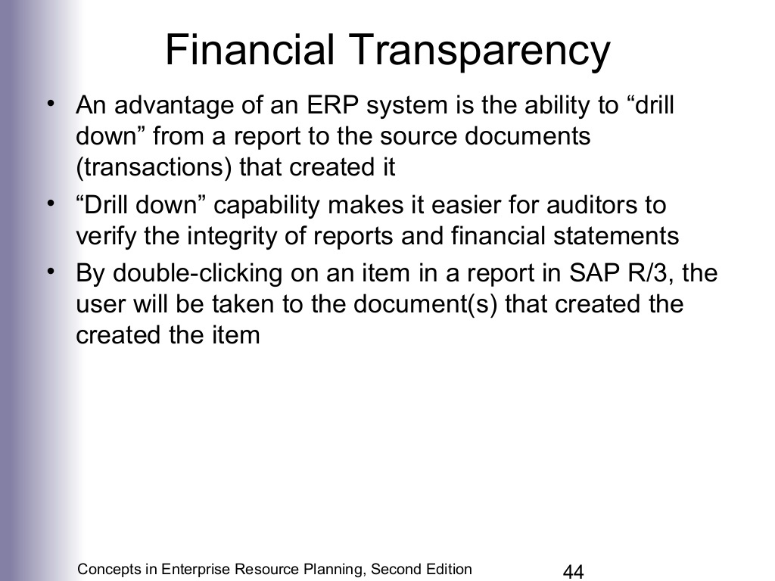

Slide 48
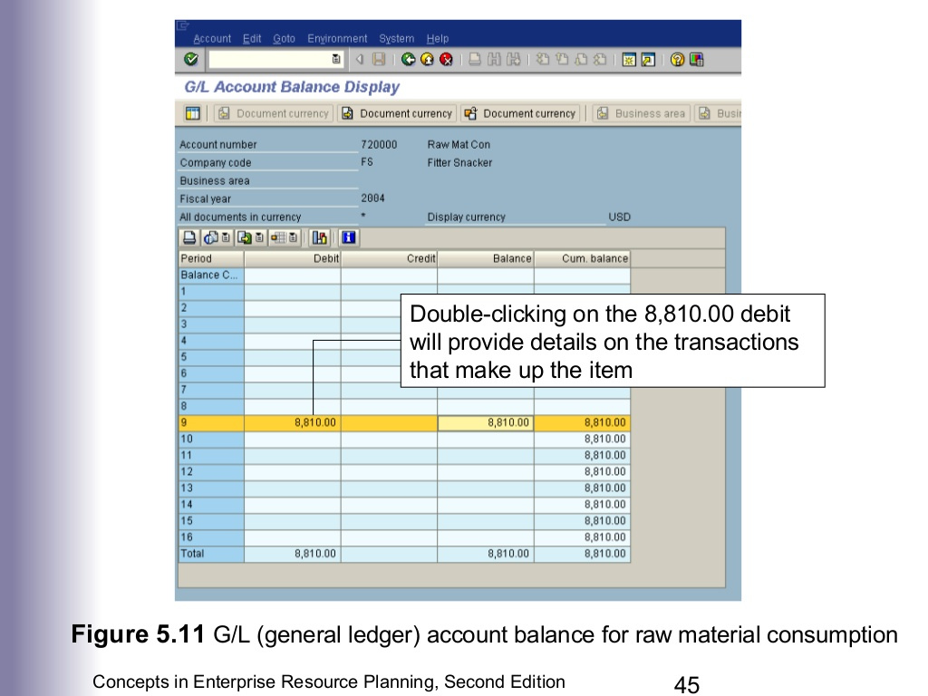

Slide 49
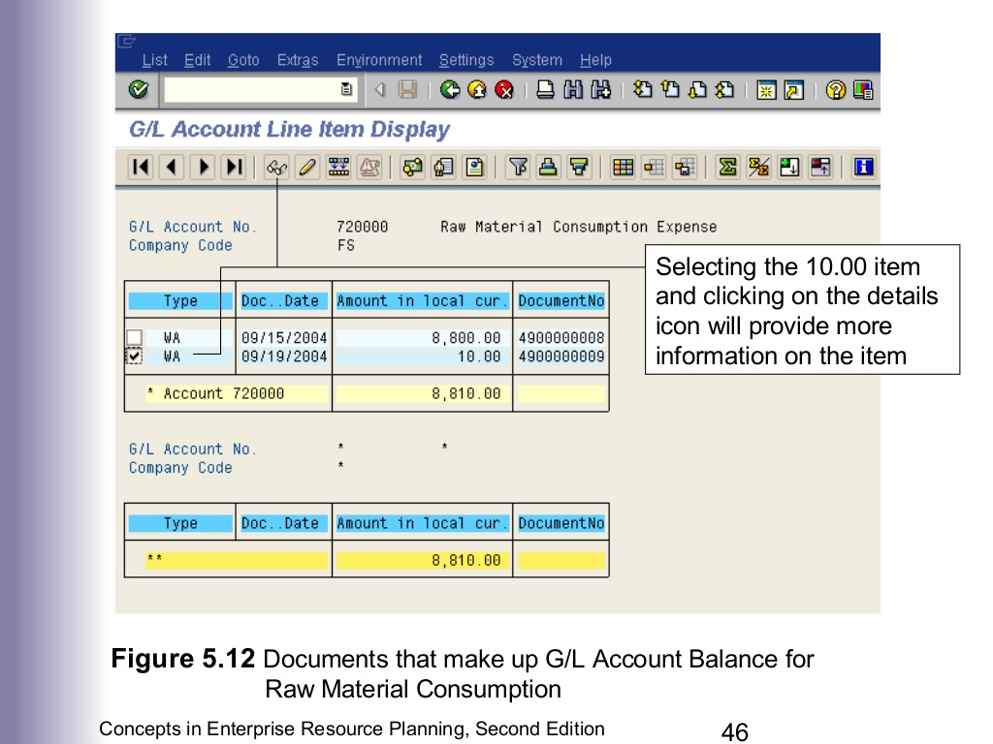

Slide 50
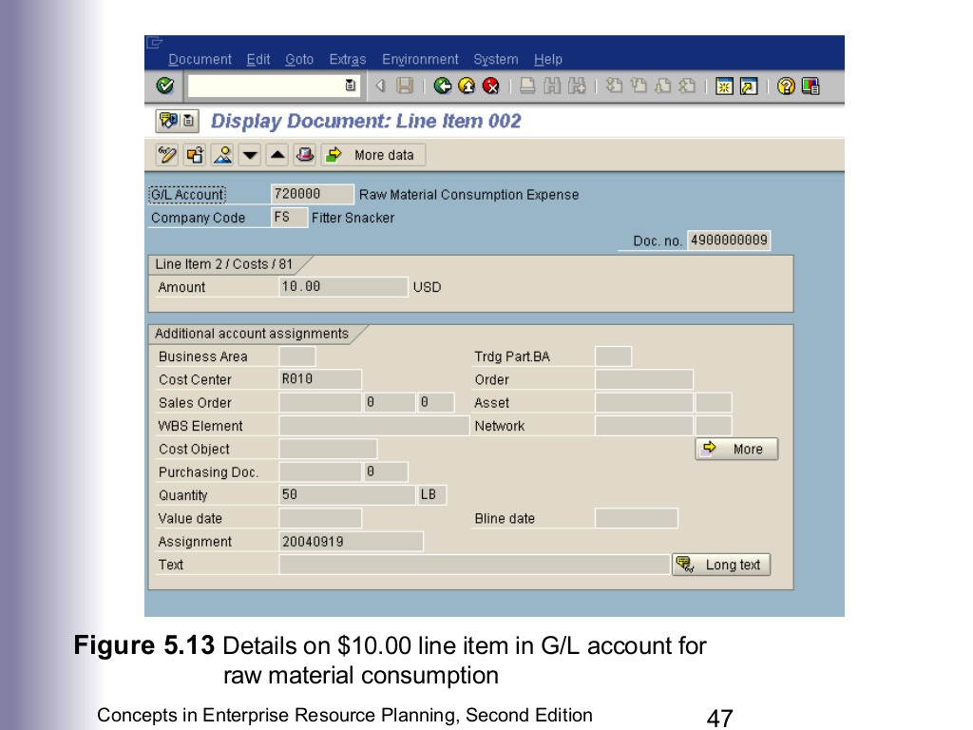

Slide 51
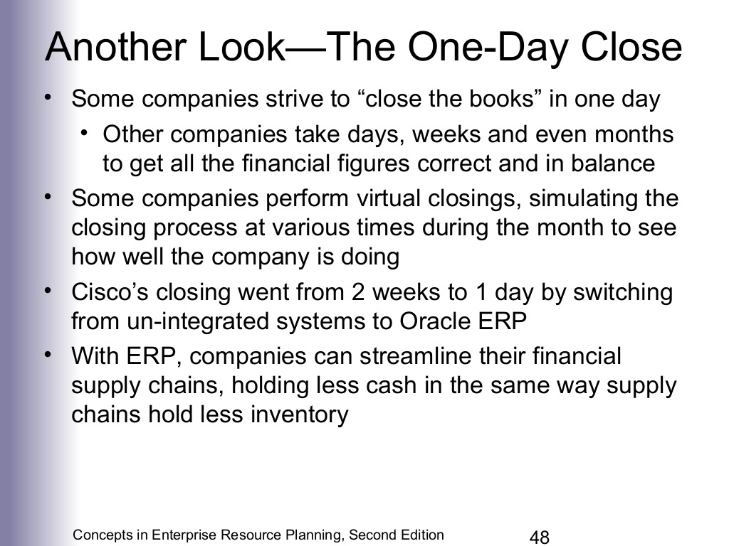

Slide 52


Slide 53


Slide 54


Slide 55


